Slide 1
Pricing-based water distribution control under water scarcity condition
117010053 Ding Laiyan
116010215 Wang Jinyu

Slide 2
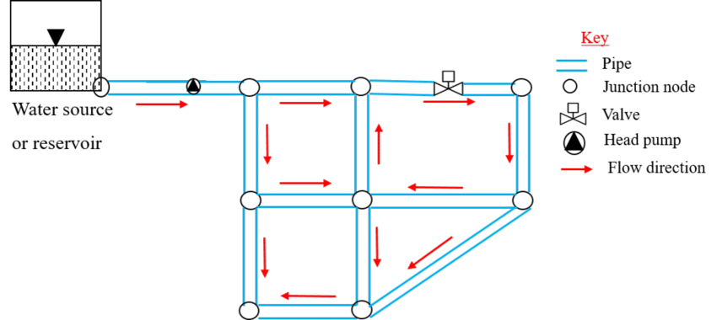
Water Distribution Network
main objective – i.e., to provide consumers with water at required pressures and flows
Other factors:
Frictions
control

Slide 3
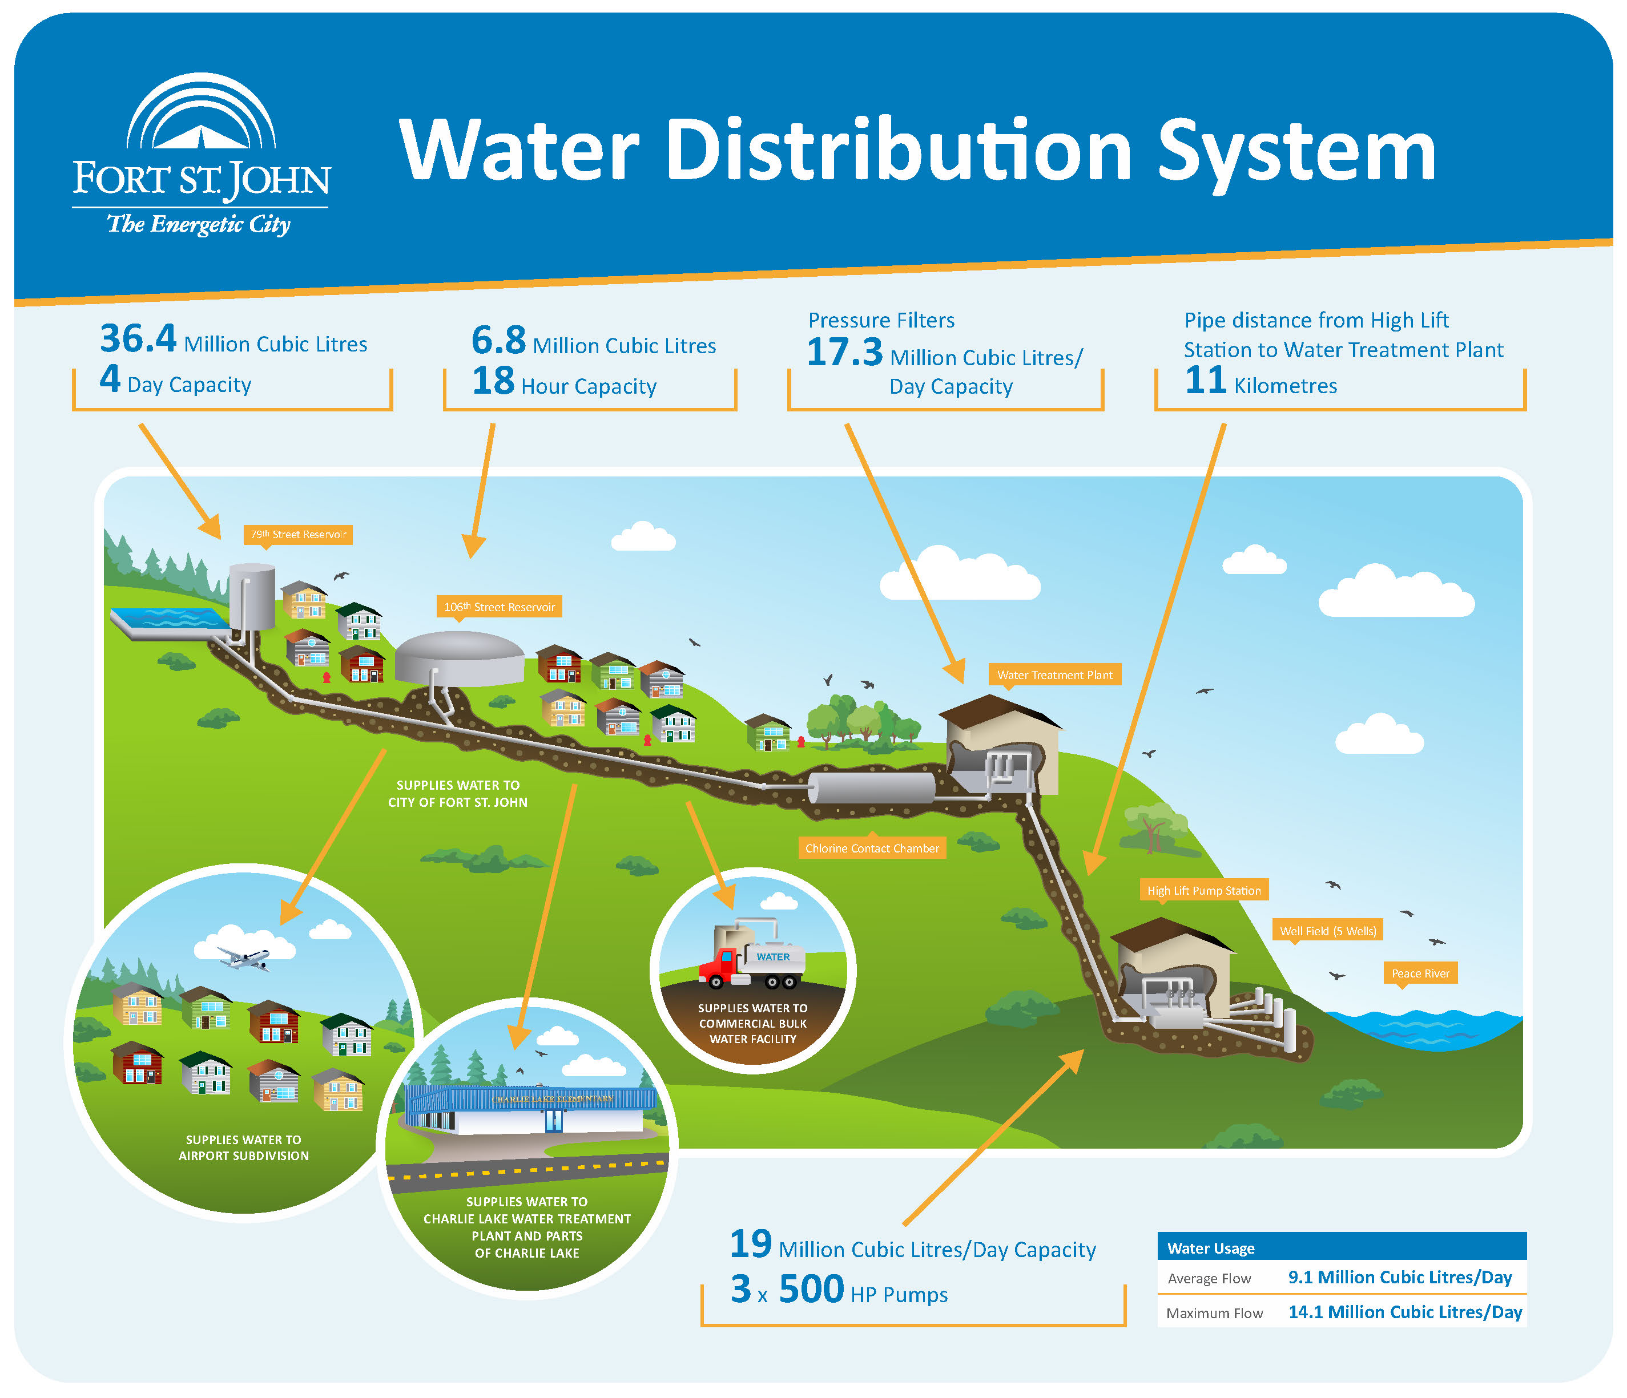
Water Distribution Network
Essential problem:
Users living at the end of pipe suffer from disadvantage of less water flow.
Kampala, Uganda (NWSC 2007).

Slide 4
Existing methods
Flow restrict
1. Restrictor to be installed on the existing water meter.
2. Two water staff members are present at each installation.
3. Only three litres per minute restrictors be utilised.

Slide 5
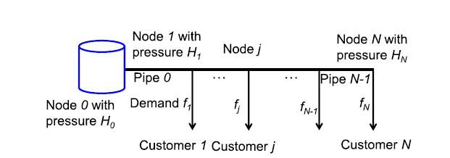
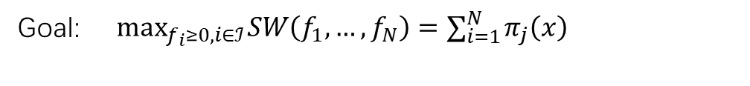
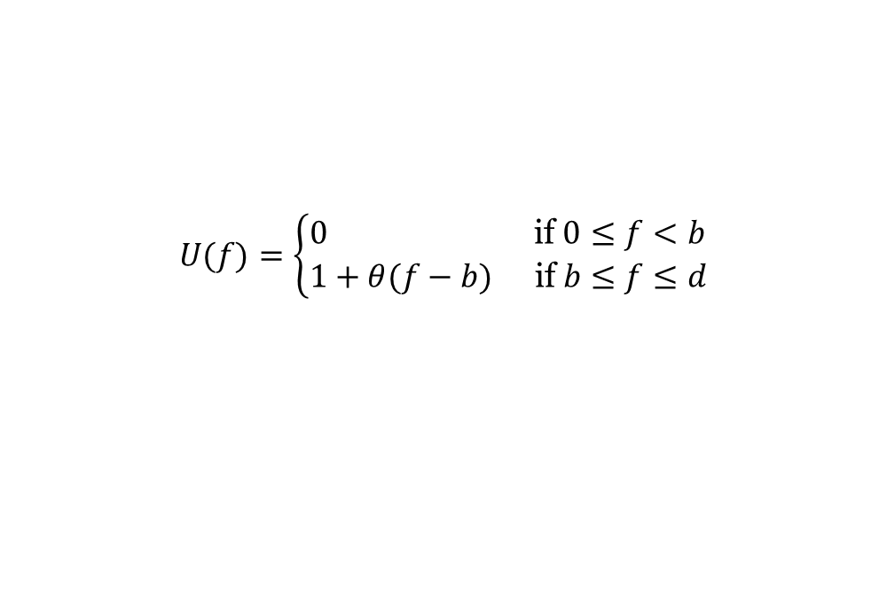
Another Solution--pricing
Goal: $\max_{f_{i}≥0,i∈ℐ} SW\left(f_{1},…,f_{N}\right)=∑_{i=1}^{N} π_{j}\left(x\right)$
$$U(f)=\left\{\begin{aligned}&0 && \text{if} 0≤f<b \\ &1+θ(f−b) && \text{if} b≤f≤d\end{aligned}\right.$$
$$π_{j}\left(x\right)=U\left(f_{j}\left(x\right)\right)−g_{j}\left(f_{j}\left(x\right)\right)$$
Lai P, Courcoubetis C, Duan L, et al. Economic Controls for Smart Water Distribution Networks Undergoing Supply Failures[J]. IEEE Transactions on Network Science and Engineering, 2020, 8(1): 555-574.

Slide 6
Proposed method
1. different utility functions
2. consider bargaining and compensation between users

